Slide 1

ENVISION
A PROGRAM OF INITIATIVES
FOR THE MIDDLE OFFICE

Slide 2
ENVISION - CONTEXT, PLANS & DELIVERABLES
Agenda
Context
    The Middle Office Function
    Current Middle Office Issues
    Known Business Demands
    Previously Identified Solutions
    Initial Conclusions
  Plans
    Setting Success Factors
    Technology Opportunities
    Known IT Plans
    Middle Office Structure Changes
  Deliverables
    Consolidated Program Timeline
    Change Management Framework
    Additional Resources
    Summary & Conclusions

Slide 3
ENVISION CONTEXT - THE MIDDLE OFFICE FUNCTION
The Middle Office sits in the centre of the full regular business process:-
Flow of business information
FRONT OFFICE
Traders
Originators
Marketers
Logistics (Global)
MIDDLE OFFICE
Risk Management
Documentation
Settlements &
Trade Accounting
Coordination (Global)
RAC - Credit & Market Risk
CORPORATE OFFICE
FIN OPS
TAX
LEGAL
TRANSACTION MANAGEMENT
INFORMATION TECHNOLOGY
Points to note
Control breaks/weaknesses within the Middle Office directly impacts all downstream users of business
information
Greater definition is needed on where boundaries to each group should lie

Slide 4
ENVISION CONTEXT - MIDDLE OFFICE ISSUES
Positives
    good people
    huge energy/commitment
    responsive
    history of reacting to business pressures

Slide 5
ENVISION CONTEXT - MIDDLE OFFICE ISSUES
Negatives
    workflow not designed for maximizing value added
    processes are not exception driven
    institutionalized manual effort due to lack of investment in control tools
    headcount growth demands & resource pull to commercial/new businesses leads to diminishing experience at time of high business volume growth (Risk Management - average experience is now 4.5 months)
    historic barriers between business silos & functions has resulted in limited synergies ie. embedded fixed cost overhead
    evidence of control breaks (Helsinki)
    lack of transparency - more bad news coming?

Slide 6
ENVISION CONTEXT - KNOWN BUSINESS DEMANDS
Known new demands of …
  MG - will require significant integration effort
  EBS - will see transfer of experienced staff on a continuous basis
  CREDIT - activities may require specialist support staff
  NETA - requires an enhanced support process which will be more
  operationally intensive than that of financial trades
  COAL/P&P - significant infrastructure challenge in Europe for this ‘growth’ businesses
  NETWORKS - ?
Compounds our existing challenges of meeting…
  rapid EOL volume growth on a operational platform which is volume sensitive (documentation, settlement & trade accounting)
  expansion of power and gas activities in the European Continent
  quality improvement in existing deliverables

Slide 7
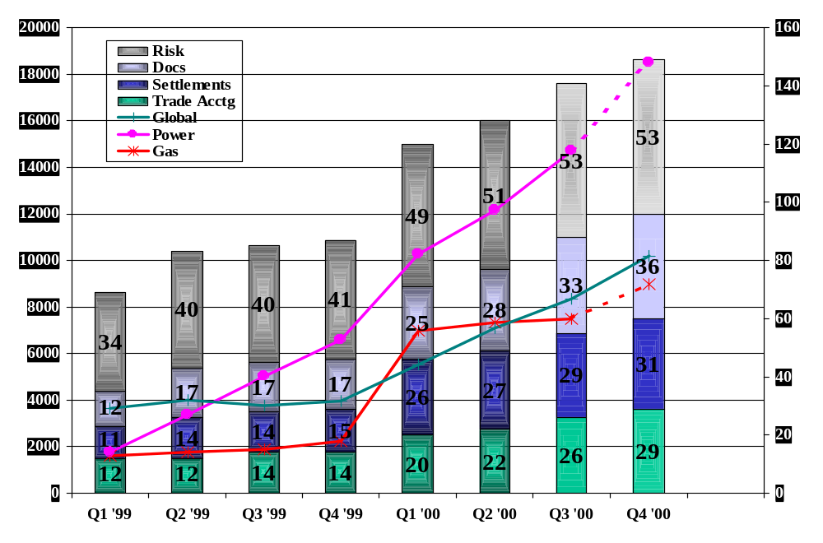
ENVISION CONTEXT - PREVIOUSLY IDENTIFIED SOLUTIONS
We have accepted volume sensitivity and increased headcount to match volume growth

Slide 8
ENVISION CONTEXT - INITIAL ‘EXECUTIVE’ CONCLUSIONS
We must improve our...
    systems infrastructure to eliminate volume sensitivity
    business processes to optimise effectiveness, now and when the systems investment is made
    control structure to promote best practices and transparency across all businesses
    forward planning
  To get to a vision of …
    distinct but linked risk control processes across all businesses
    homogenous documentation, settlement and accounting control processes
ENVISION IS THE PROGRAM
OF INITIATIVES WHICH MOVES US TOWARDS OUR VISION

Slide 9
ENVISION PLANS - SETTING SUCCESS FACTORS
    significant reduction in volume sensitivity for headcount
    elimination of business and function barriers - creating synergies within Middle Office
    significant elimination of manual workarounds
    design of exception based processes

Slide 10
ENVISION PLANS - THE NEW TECHNOLOGY OPPORTUNITIES
Component based application architecture and TIBCO messaging can generate...
    a data warehousing solution that covers all businesses
    E- support opportunities for settlement and documentation
    flexible IT resourcing opportunities
Note:- The plan for Envision initiatives should have the
above as key deliverables

Slide 11
ENVISION PLANS - KNOWN IT PLANS
Should be revalidated/replanned around core deliverables
    Enpower for UK Power, including NETA functionality
    The THUNDERBALL program for Global Liquids and Coal
    The ENLIGHTEN data warehouse which creates a cross product straight through processing (‘STP’) architecture for the Middle Office incorporating a single point of entry, control and reference for all data
    The Daily Trading Ledger which creates a seamless electronic link between valuation tools, risk management reporting and the company’s books and records ie. SAP G/L
    The replacement of the volume sensitive LOIS, LOM & BOSS systems with Envoice
    The implementation of numerous business process & system changes for contract documentation
  Note:- After sufficiency of resourcing the most significant issue facing us is
  that IT plans have been‘silo or business’ led (e.g. THUNDERBALL)
  and not referenced to a global or regional IT roadmap.

Slide 12
ENVISION PLANS - MIDDLE OFFICE STRUCTURE CHANGE
    stripe concept - define each Middle Office function
    enhance accountabilities - particularly at manager/director level
    enforce role responsibilities, not task ownership - particularly at more junior levels
    agree transparent interfaces between groups/functions (RAC, LEGAL, MO)
    improve communication, respect, education & motivation

Slide 13
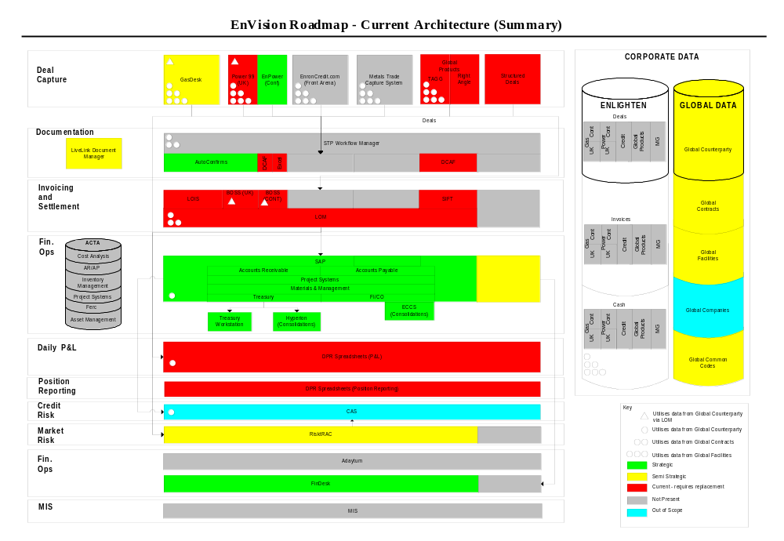
ENVISION DELIVERABLES- CONSOLIDATED PROGRAM TIMELINE - CURRENT ARCHITECTURE (SUMMARY)

Slide 14
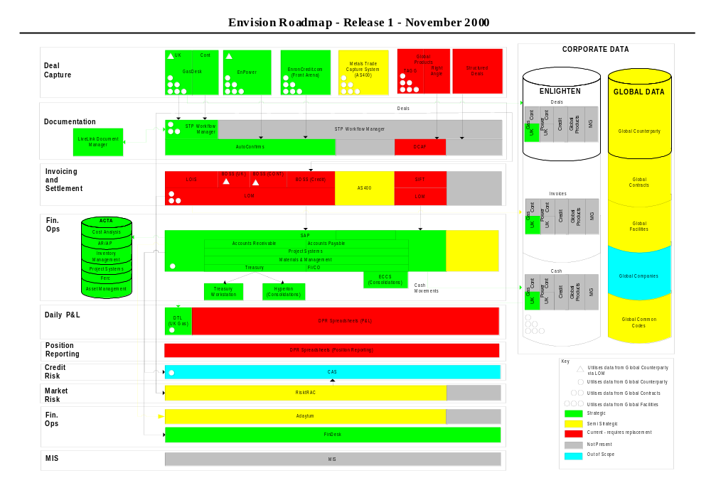
ENVISION DELIVERABLES- CONSOLIDATED PROGRAM TIMELINE - RELEASE 1

Slide 15
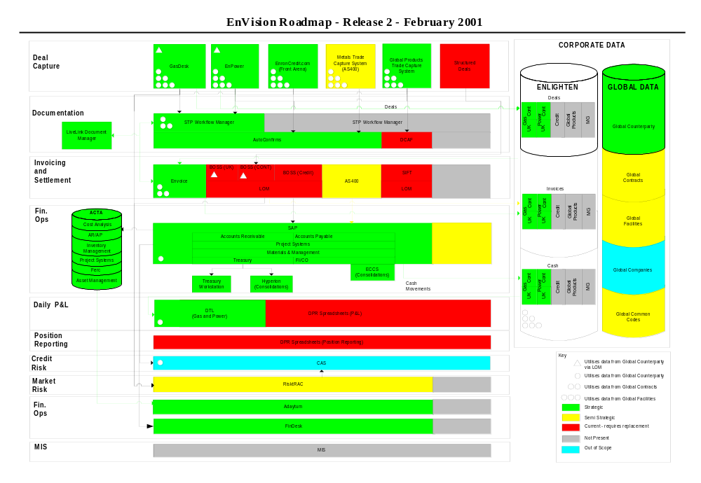
ENVISION DELIVERABLES- CONSOLIDATED PROGRAM TIMELINE - RELEASE 2

Slide 16
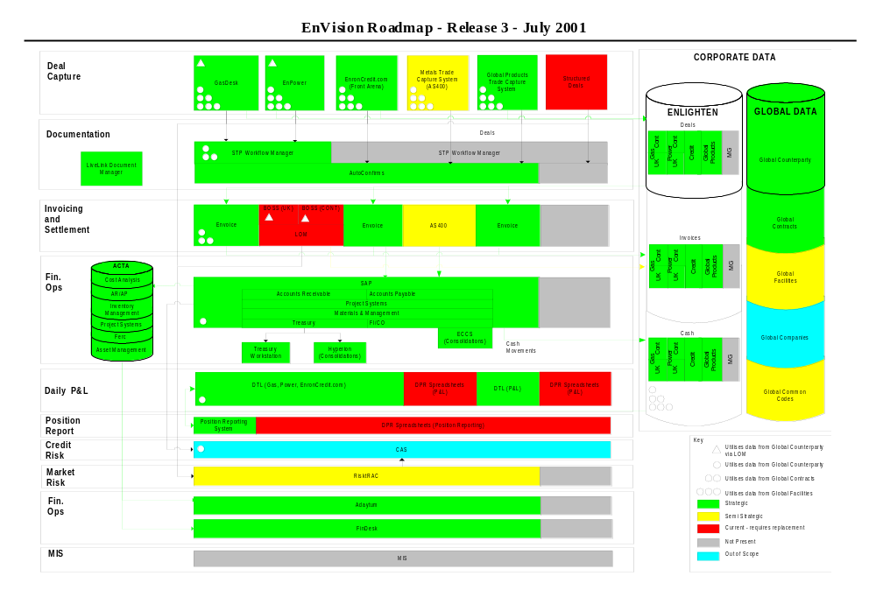
ENVISION DELIVERABLES- CONSOLIDATED PROGRAM TIMELINE - RELEASE 3

Slide 17
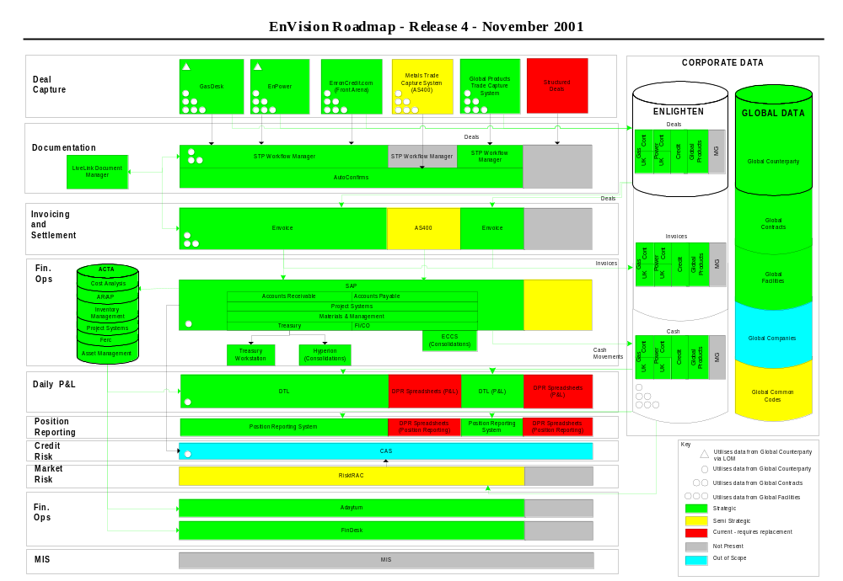
ENVISION DELIVERABLES- CONSOLIDATED PROGRAM TIMELINE - RELEASE 4

Slide 18
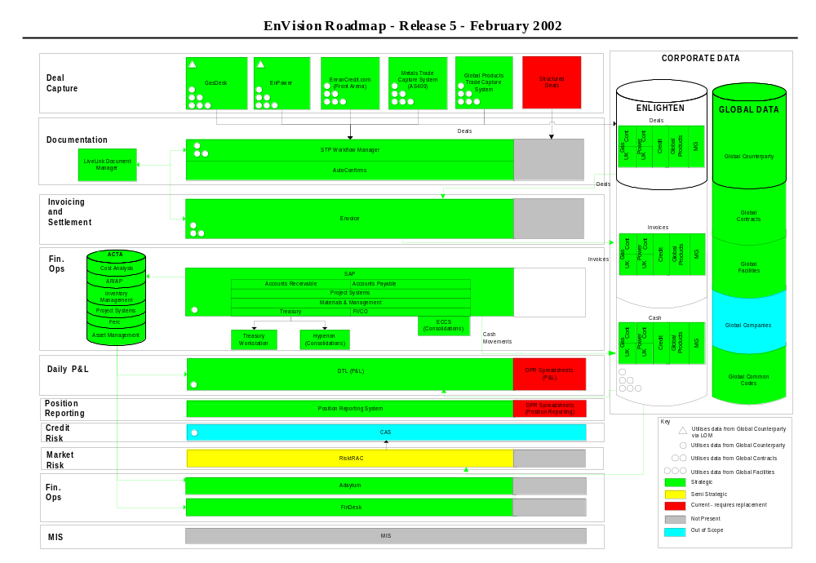
ENVISION DELIVERABLES- CONSOLIDATED PROGRAM TIMELINE - RELEASE 5

Slide 19
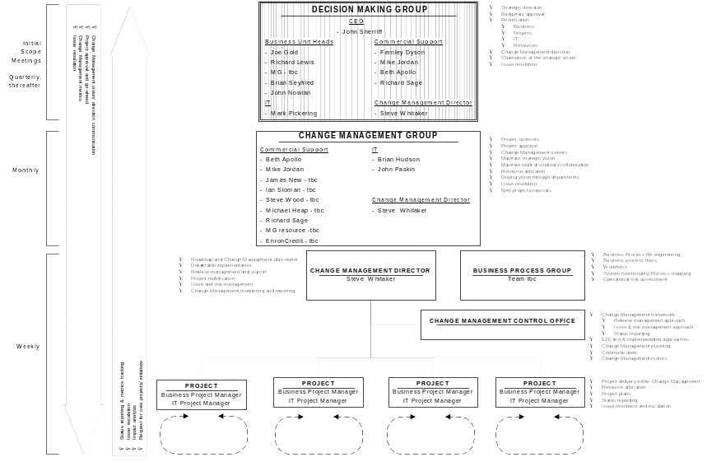
ENVISION DELIVERABLES-
CHANGE MANAGEMENT FRAMEWORK

Slide 20
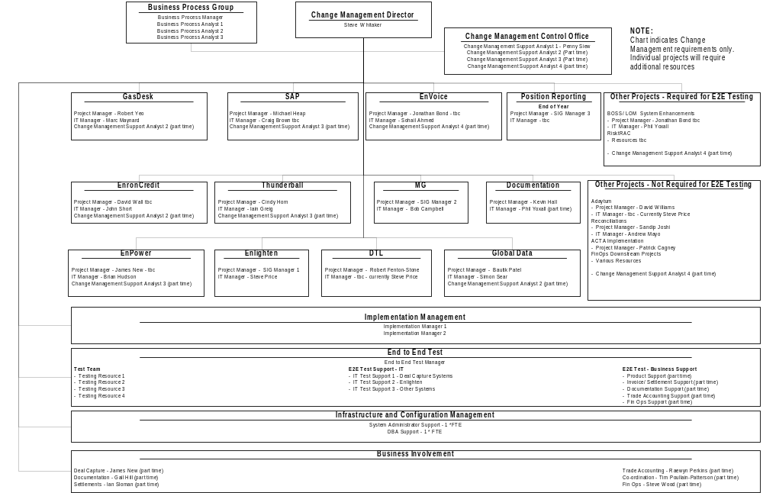
ENVISION DELIVERABLES-
CHANGE MANAGEMENT FRAMEWORK

Slide 21
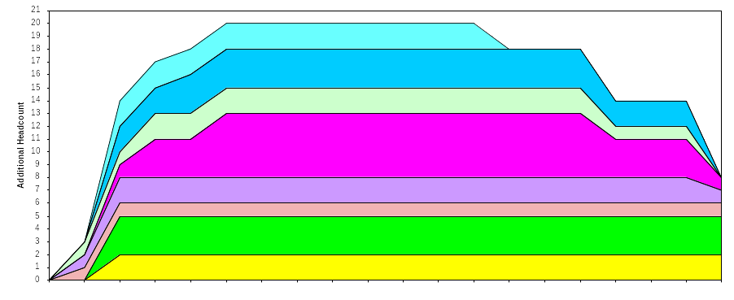
ENVISION DELIVERABLES - ADDITIONAL RESOURCES
Release to Risk Management
Business Process Group
Change Management Control Office
Release to SIG
Implementation Management
Release to IT/ SIG
Release to SIG
End to End Testing
Release to IT/ SIG
Release to Middle Office
Business Project Management
Release to Settlements
IT Project Management
IT End to End Testing Support
Infrastructure and Configuration Management
Release 1
Release 2
Release 3
Release 4
Release 5
Key Assumptions:
2 Business Process Group resources are currently available from project re-organisation
Release 1 can be delivered based on current plans and resources
Note:
A project manager for MG has not been included
The additional resources highlighted here are for the overall Change Management function - individual projects may require additional resources

Slide 22
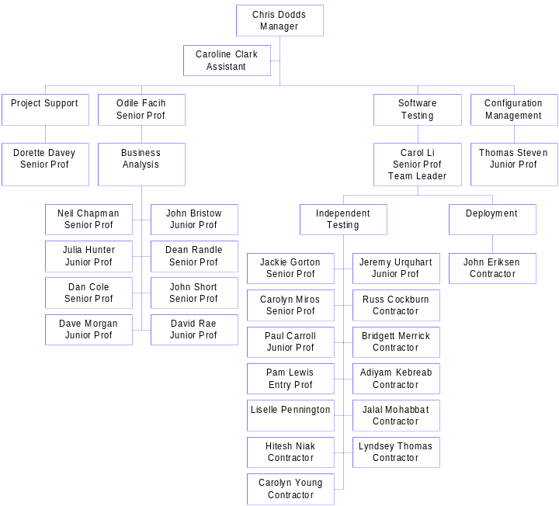
ENVISION DELIVERABLES- ADDITIONAL RESOURCES: A POTENTIAL SOLUTION
The IT Development Support Group has resources, with appropriate skill sets to meet many of the additional resource requirements

Slide 23
ENVISION DELIVERABLES-
SUMMARY & CONCLUSIONS
We need to …
    accept operational risk assessment and the need to move forward on a structural basis
    receive a mandate to action program- obtain business sponsorship and initiate ‘governance’ process for program
    approve timelines/costs

